Slide 1


eduke
EDUKE
Academic Performance Prediction System with AI
A web-based AI-powered platform designed to track student performance, enhance communication, and provide predictive insights. By analyzing academic data, Eduke helps teachers and parents support students effectively, ensuring better learning outcomes.
SAIN SABURAJ
MCA 23

Slide 2


eduke
Introduction to
EDUKE
Eduke is an AI-powered academic performance prediction and management system designed to enhance the learning experience for students, teachers, and parents. By analyzing key academic metrics such as attendance, marks, and student behavior, Eduke provides data-driven insights to predict performance trends.
The platform incorporates AI-Based Performance Prediction to assess student progress, an Automated Grading System to streamline quiz and assessment evaluations, and an Advanced AI Chatbot for academic guidance and query resolution. Additionally, Eduke features Auto-Generated Reports for attendance and performance tracking and an Adaptive Learning System that offers personalized study recommendations.
With seamless communication between students, teachers, and parents, Eduke aims to revolutionize how educational institutions monitor and improve student success.

Slide 3





eduke
Users of EDUKE
ADMIN
CLASS HEAD
SUBJECT HEAD
STUDENT
PARENT
Manages the system, adds and oversees classes and teachers, and ensures smooth operation of the platform.
Acts as the primary teacher for a class, manages student records, assigns subjects, and communicates with students and parents.
Handles subject-specific activities, including assessments, study materials, and direct communication with students.
Accesses study materials, submits assignments, participates in quizzes, and communicates with teachers for academic guidance.
Monitors the student’s academic progress, attendance, and performance while staying connected with teachers for updates.

Slide 4
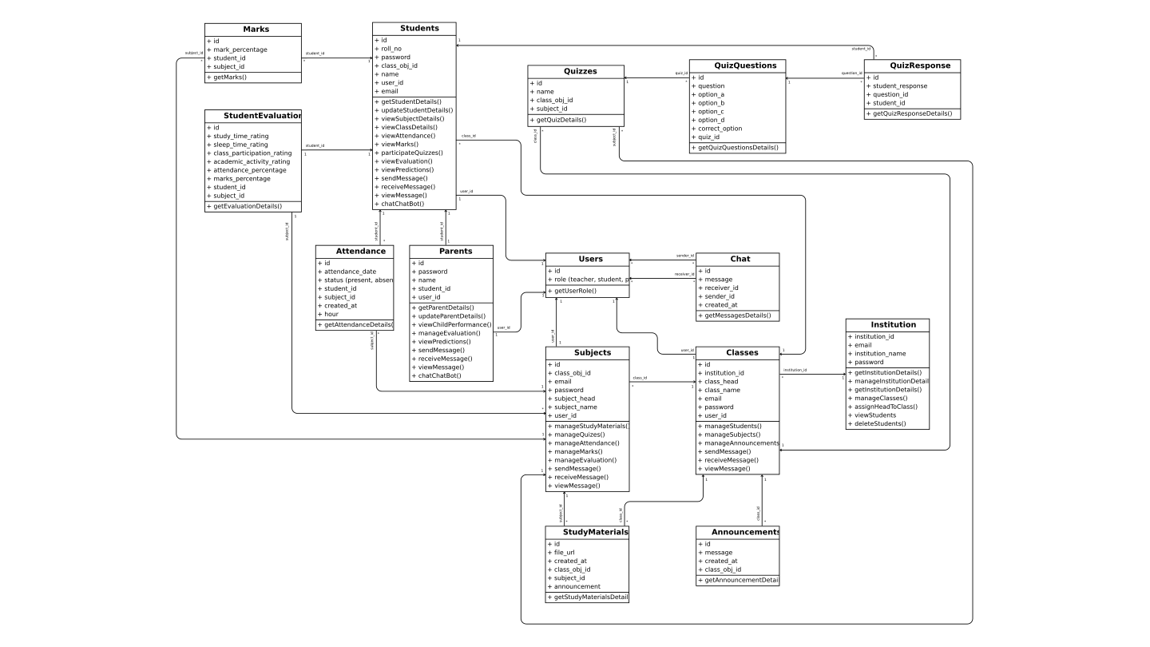
eduke
Class Diagram

Slide 5
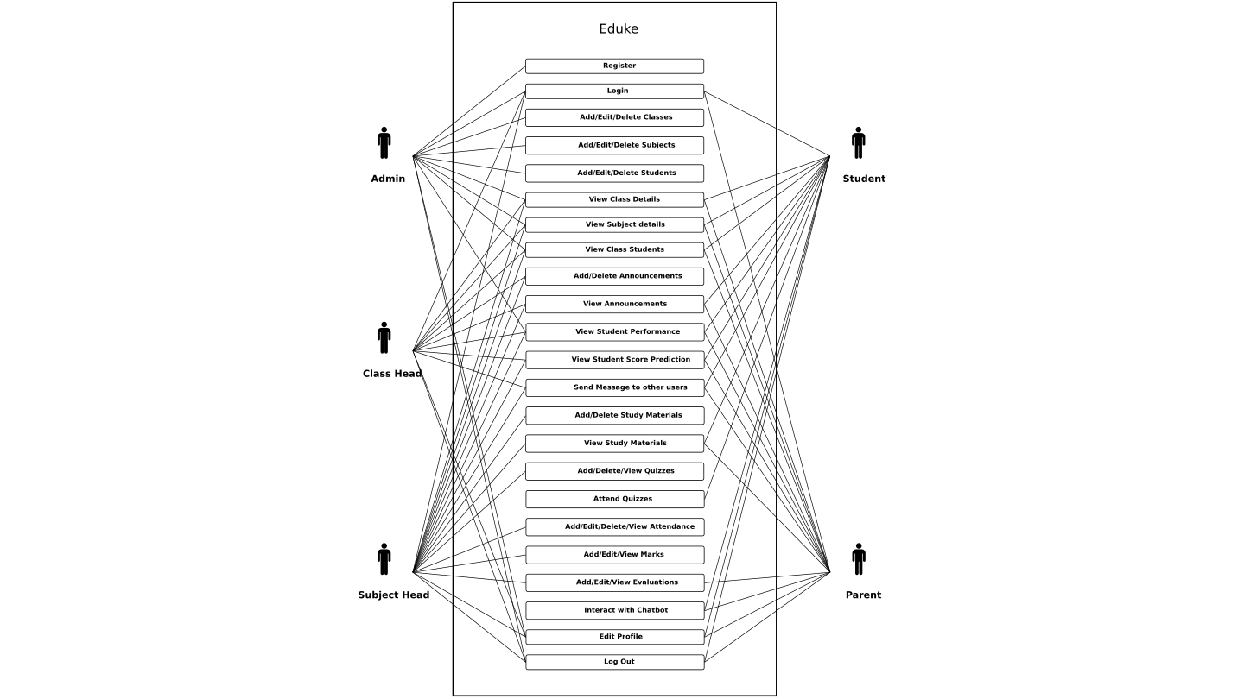
eduke
Use Case Diagram

Slide 6
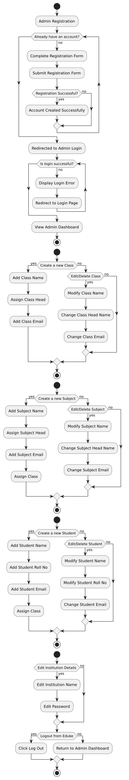
eduke
Activity Diagram - Admin

Slide 7
eduke
Activity Diagram - Admin

Slide 8
eduke
Activity Diagram - Admin

Slide 9
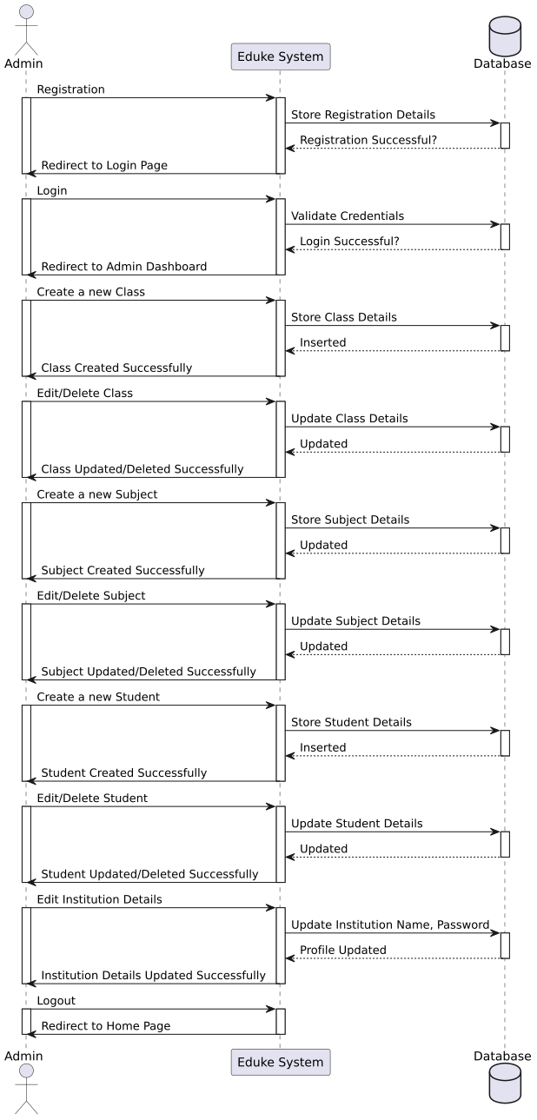
eduke
Sequnce Diagram - Admin

Slide 10
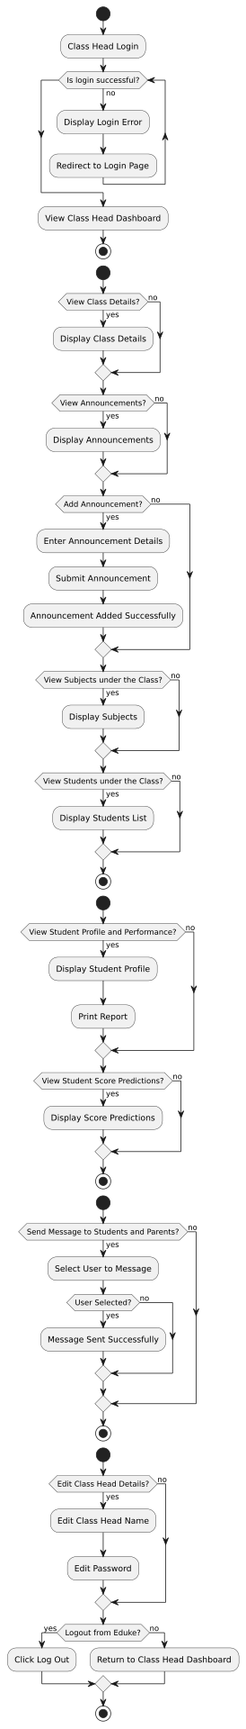
eduke
Activity Diagram - Class Head

Slide 11
eduke
Activity Diagram - Class Head

Slide 12
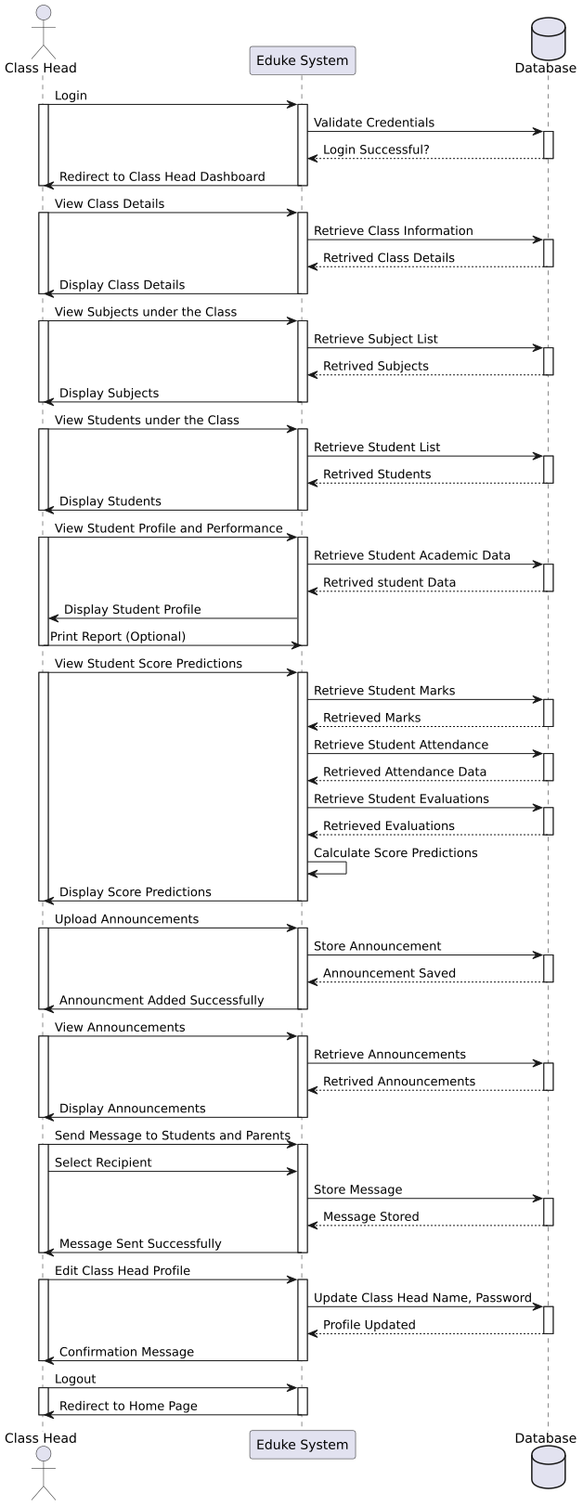
eduke
Sequence Diagram - Class Head

Slide 13
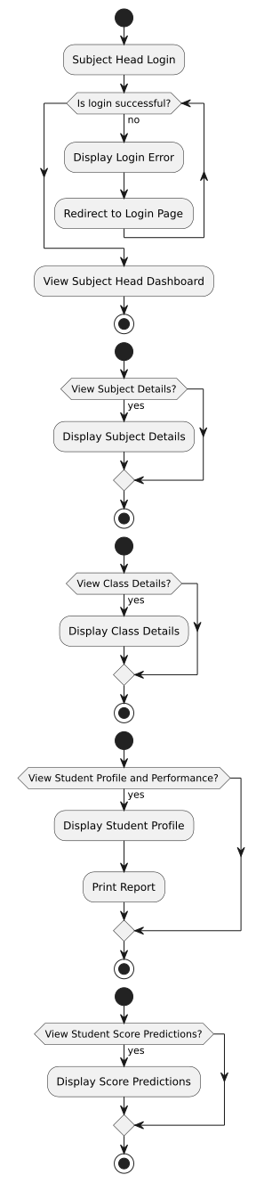
eduke
Activity Diagram - Subject Head

Slide 14
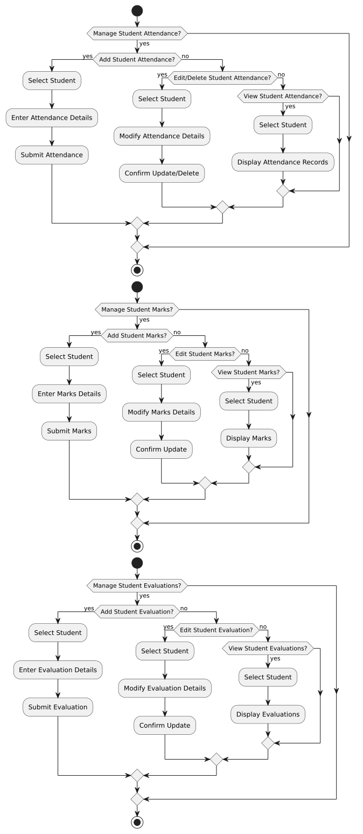
eduke
Activity Diagram - Subject Head

Slide 15
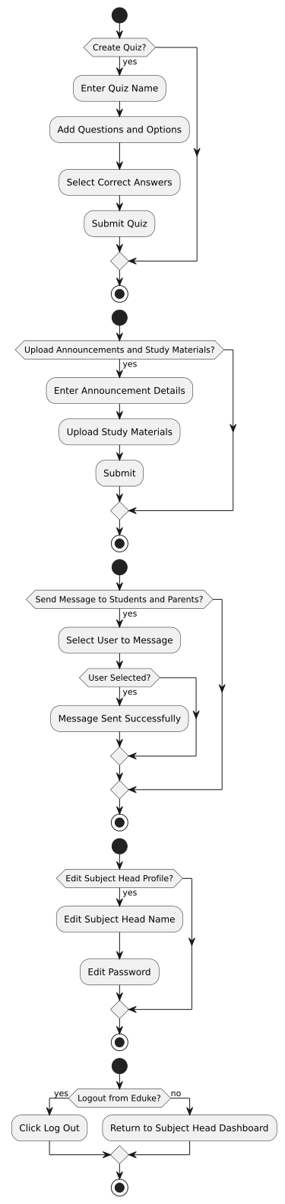
eduke
Activity Diagram - Subject Head

Slide 16
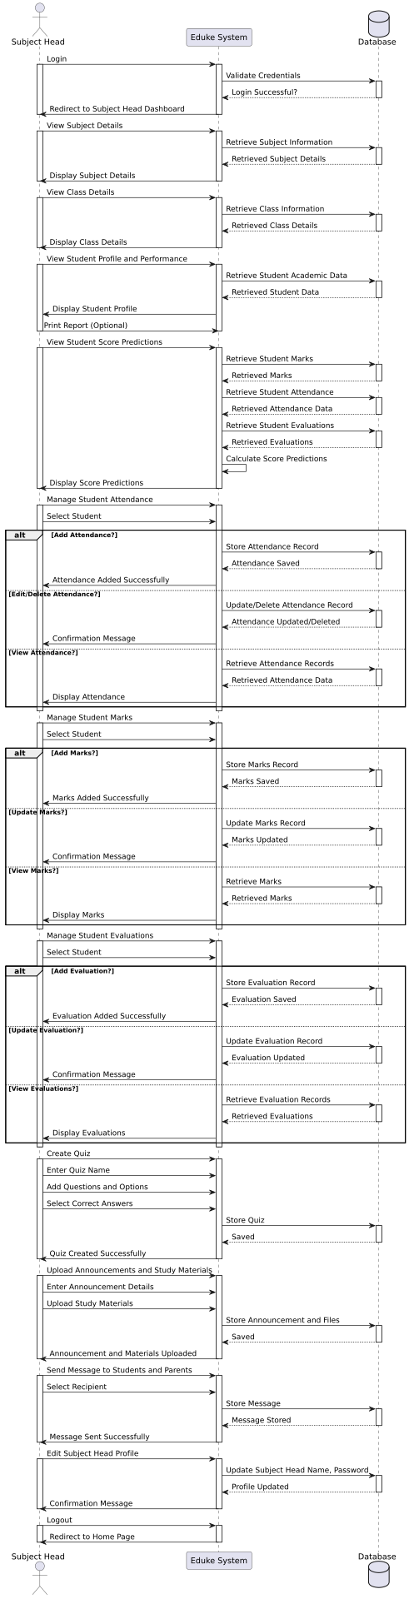
eduke
Sequence Diagram - Subject Head

Slide 17
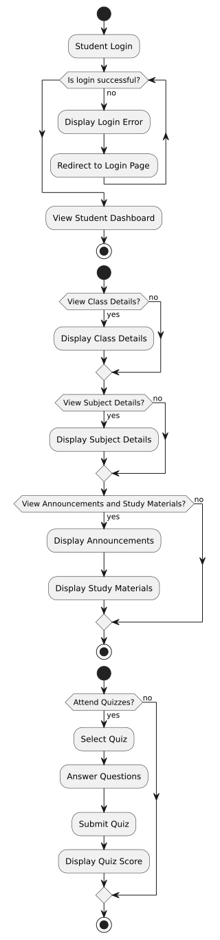
eduke
Activity Diagram - Student

Slide 18
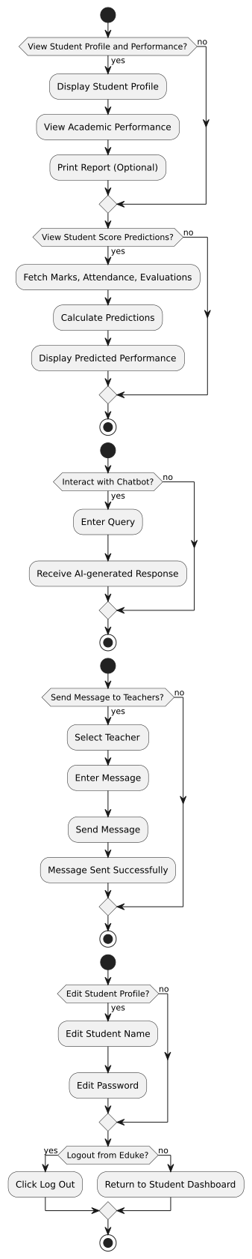
eduke
Activity Diagram - Student

Slide 19
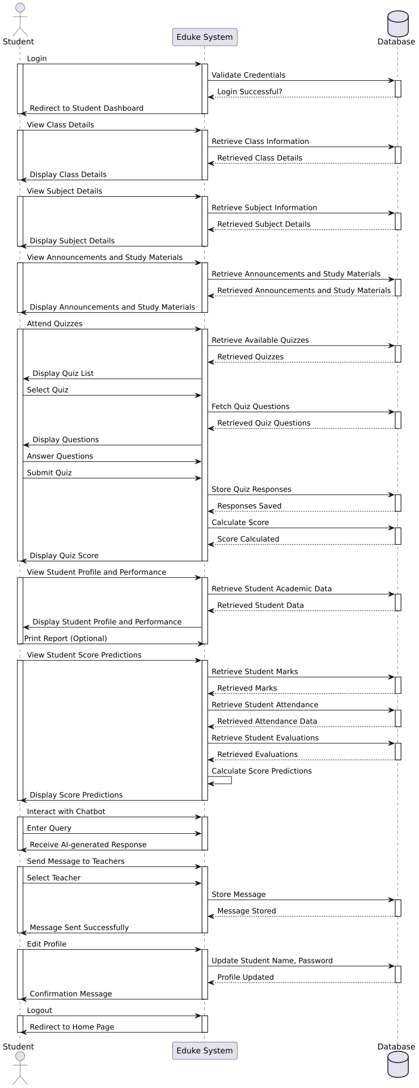
eduke
Sequence Diagram - Student

Slide 20
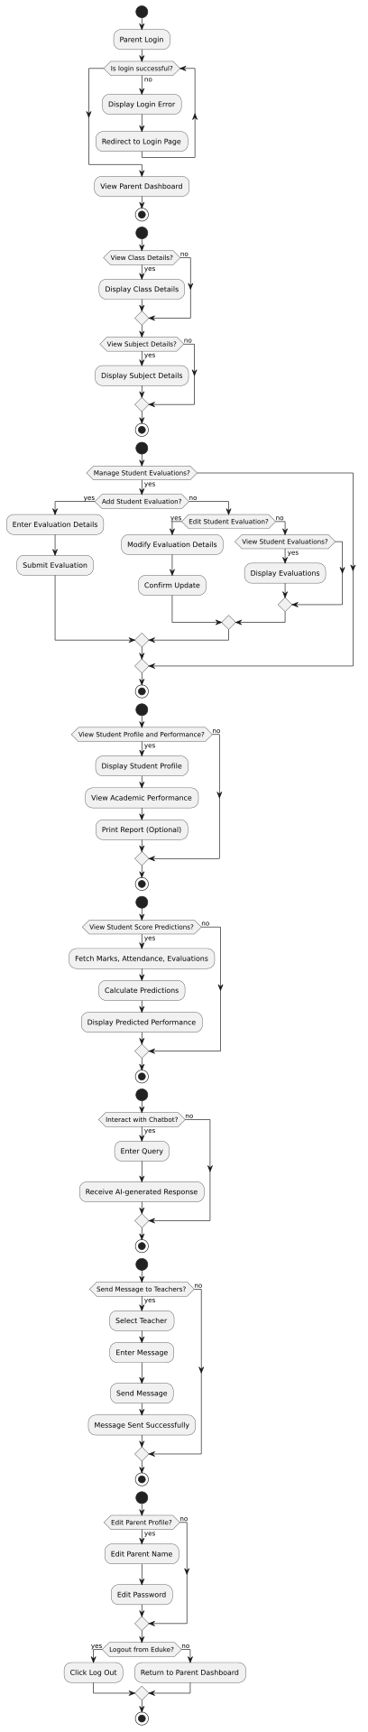
eduke
Activity Diagram - Parent

Slide 21
eduke
Activity Diagram - Parent

Slide 22
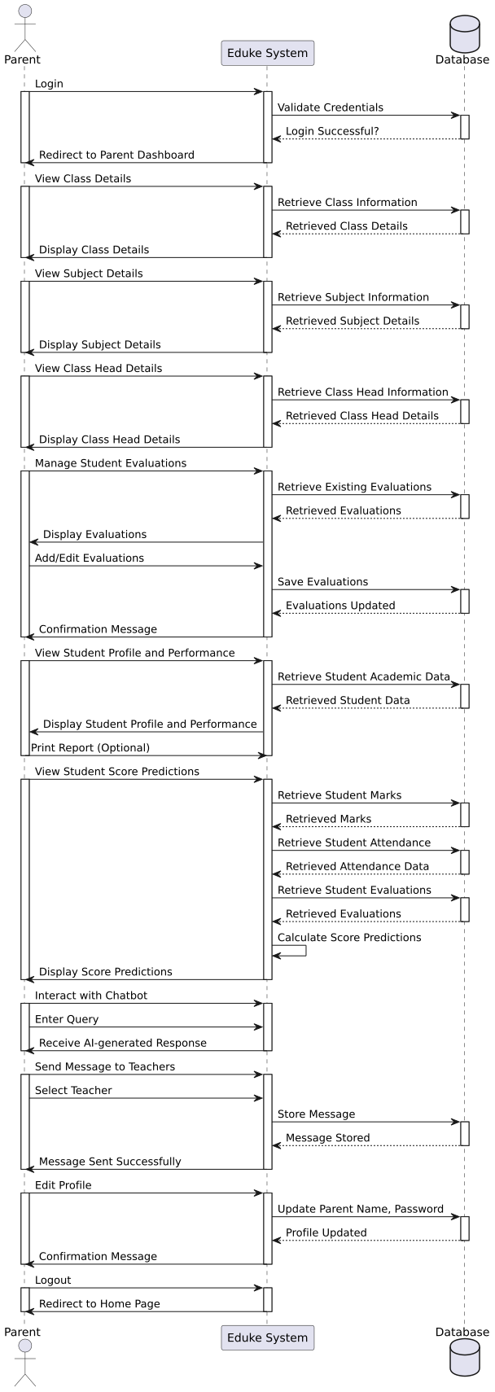
eduke
Sequence Diagram - Parent

Slide 23
eduke
Table - Institution
COLUMN NAME | DATA TYPE | CONSTRAINTS | DESCRIPTION
institution_id | INT | PRIMARY KEY, AUTO_INCREMENT | Unique ID for institution
email | VARCHAR(255) | NOT NULL, UNIQUE | Institution email
institution_name | VARCHAR(255) | NOT NULL | Name of the institution
password | VARCHAR(255) | NOT NULL | Institution's password

Slide 24
eduke
Table - Classes
COLUMN NAME | DATA TYPE | CONSTRAINTS | DESCRIPTION
id | INT | PRIMARY KEY, AUTO_INCREMENT | Unique ID for the class
class_name | VARCHAR(255) | NOT NULL | Name of the class
class_head | VARCHAR(255) | NOT NULL | Teacher managing the class
email | VARCHAR(255) | NOT NULL, UNIQUE | Class head's email
password | VARCHAR(255) | NOT NULL | Class head's password
user_id | INT | FOREIGN KEY → users.id | Links to the users table
institution_id | INT | FOREIGN KEY → institution.institution_id | Institution this class belongs to

Slide 25
eduke
Table - Subjects
COLUMN NAME | DATA TYPE | CONSTRAINTS | DESCRIPTION
id | INT | PRIMARY KEY, AUTO_INCREMENT | Unique subject ID
subject_name | VARCHAR(255) | NOT NULL | Name of the subject
subject_head | VARCHAR(255) | NOT NULL | Teacher responsible for the subject
email | VARCHAR(255) | NOT NULL, UNIQUE | Subject head's email
password | VARCHAR(255) | NOT NULL | Subject head's password
user_id | INT | FOREIGN KEY → users.id | Links to the users table
class_obj_id | INT | FOREIGN KEY → classes.id | Class this subject belongs to

Slide 26
eduke
Table - Students
COLUMN NAME | DATA TYPE | CONSTRAINTS | DESCRIPTION
id | INT | PRIMARY KEY, AUTO_INCREMENT | Unique student ID
roll_no | VARCHAR(50) | UNIQUE, NOT NULL | Student's roll number
password | VARCHAR(255) | NOT NULL | Student's password
name | VARCHAR(255) | NOT NULL | Student's full name
class_obj_id | INT | FOREIGN KEY → classes.id | Class student belongs to (Nullable)
user_id | INT | FOREIGN KEY → users.id | Links to the users table
email | VARCHAR(255) | NOT NULL, UNIQUE | Student's email

Slide 27
eduke
Table - Parents
COLUMN NAME | DATA TYPE | CONSTRAINTS | DESCRIPTION
id | INT | PRIMARY KEY, AUTO_INCREMENT | Unique parent ID
student_id | VARCHAR(50) | FOREIGN KEY → students.roll_no | Links to student using roll number
password | VARCHAR(255) | NOT NULL | Parent's password
name | VARCHAR(255) | NULLABLE | Parent's name (NULL if not provided)
user_id | INT | FOREIGN KEY → users.id | Links to the users table

Slide 28
eduke
Table - Marks
COLUMN NAME | DATA TYPE | CONSTRAINTS | DESCRIPTION
id | INT | PRIMARY KEY, AUTO_INCREMENT | Unique mark entry ID
student_id | INT | FOREIGN KEY → students.id | Student's ID
subject_id | INT | FOREIGN KEY → subjects.id | Subject ID
mark_percentage | DECIMAL(5,2) | NOT NULL | Marks in percentage

Slide 29
eduke
Table - Attendance
COLUMN NAME | DATA TYPE | CONSTRAINTS | DESCRIPTION
id | INT | PRIMARY KEY, AUTO_INCREMENT | Unique attendance ID
student_id | INT | FOREIGN KEY → students.id | Student's ID
subject_id | INT | FOREIGN KEY → subjects.id | Subject ID
attendance_date | DATE | NOT NULL | Date of attendance
status | ENUM('present', 'absent') | NOT NULL | Attendance status
created_at | TIMESTAMP | DEFAULT CURRENT_TIMESTAMP | Timestamp of message
hour | SMALLINT | NOT NULL | Attendance Hour

Slide 30
eduke
Table - Student_Evaluation
COLUMN NAME | DATA TYPE | CONSTRAINTS | DESCRIPTION
id | INT | PRIMARY KEY, AUTO_INCREMENT | Unique evaluation ID
student_id | INT | FOREIGN KEY → students.id | Student ID
subject_id | INT | FOREIGN KEY → subjects.id | Subject being evaluated
study_time_rating | DOUBLE | NOT NULL | Evaluation for study time
sleep_time_rating | DOUBLE | NOT NULL | Evaluation for sleep habits
class_participation_rating | DOUBLE | NOT NULL | Evaluation for class participation
academic_participation_rating | DOUBLE | NOT NULL | Evaluation for academic activity
attendance_percentage | DOUBLE | NOT NULL | Attendance percentage
marks_percentage | DOUBLE | NOT NULL | Marks percentage

Slide 31
eduke
Table - Chat
COLUMN NAME | DATA TYPE | CONSTRAINTS | DESCRIPTION
id | INT | PRIMARY KEY, AUTO_INCREMENT | Unique chat message ID
message | LONGTEXT | NOT NULL | Message content
sender_id | INT | FOREIGN KEY → users.id | Sender's user ID
receiver_id | INT | FOREIGN KEY → users.id | Receiver's user ID
created_at | TIMESTAMP | DEFAULT CURRENT_TIMESTAMP | Timestamp of message

Slide 32
eduke
Table - Users
COLUMN NAME | DATA TYPE | CONSTRAINTS | DESCRIPTION
id | INT | PRIMARY KEY, AUTO_INCREMENT | Unique user ID
role | ENUM('class_head', 'subject_head', 'student', 'parent') | NOT NULL | User role

Slide 33
eduke
Table - Quizzes
COLUMN NAME | DATA TYPE | CONSTRAINTS | DESCRIPTION
id | INT | PRIMARY KEY, AUTO_INCREMENT | Unique quiz ID
name | VARCHAR(255) | NOT NULL | Name of the quiz
class_obj_id | INT | FOREIGN KEY → classes.id | Class the quiz belongs to (Nullable)
subject_id | INT | FOREIGN KEY → subjects.id | Subject the quiz belongs to

Slide 34
eduke
Table - Quiz_Questions
COLUMN NAME | DATA TYPE | CONSTRAINTS | DESCRIPTION
id | INT | PRIMARY KEY, AUTO_INCREMENT | Unique question ID
quiz_id | INT | FOREIGN KEY → quizzes.id | Related quiz ID
question | LONGTEXT | NOT NULL | Quiz question
option_a | VARCHAR(255) | NOT NULL | Option A
option_b | VARCHAR(255) | NOT NULL | Option B
option_c | VARCHAR(255) | NOT NULL | Option C
option_d | VARCHAR(255) | NOT NULL | Option D
correct_option | VARCHAR(1) | NOT NULL | Correct answer

Slide 35
eduke
Table - Quiz_Response
COLUMN NAME | DATA TYPE | CONSTRAINTS | DESCRIPTION
id | INT | PRIMARY KEY, AUTO_INCREMENT | Unique response ID
student_response | VARCHAR(1) | NOT NULL | Student's selected answer
question_id | INT | FOREIGN KEY → quiz_questions.id | Related quiz question ID
student_id | INT | FOREIGN KEY → students.id | Student who attempted the question

Slide 36
eduke
Table - Announcements
COLUMN NAME | DATA TYPE | CONSTRAINTS | DESCRIPTION
id | INT | PRIMARY KEY, AUTO_INCREMENT | Unique announcement ID
message | LONGTEXT | NOT NULL | Announcement content
created_at | TIMESTAMP | DEFAULT CURRENT_TIMESTAMP | Time when the announcement was made
class_obj_id | INT | FOREIGN KEY → classes.id | Class associated with the announcement

Slide 37
eduke
Table - Study_Materials
COLUMN NAME | DATA TYPE | CONSTRAINTS | DESCRIPTION
id | INT | PRIMARY KEY, AUTO_INCREMENT | Unique study material ID
file_url | LONGTEXT | NOT NULL | URL or path to the study material file
created_at | TIMESTAMP | DEFAULT CURRENT_TIMESTAMP | Timestamp when the material was uploaded
class_obj_id | INT | FOREIGN KEY → classes.id | Class associated with the study material
subject_id | INT | FOREIGN KEY → subjects.id | Subject associated with the study material
announcement | LONGTEXT | NULLABLE | Optional announcement or description

Slide 38
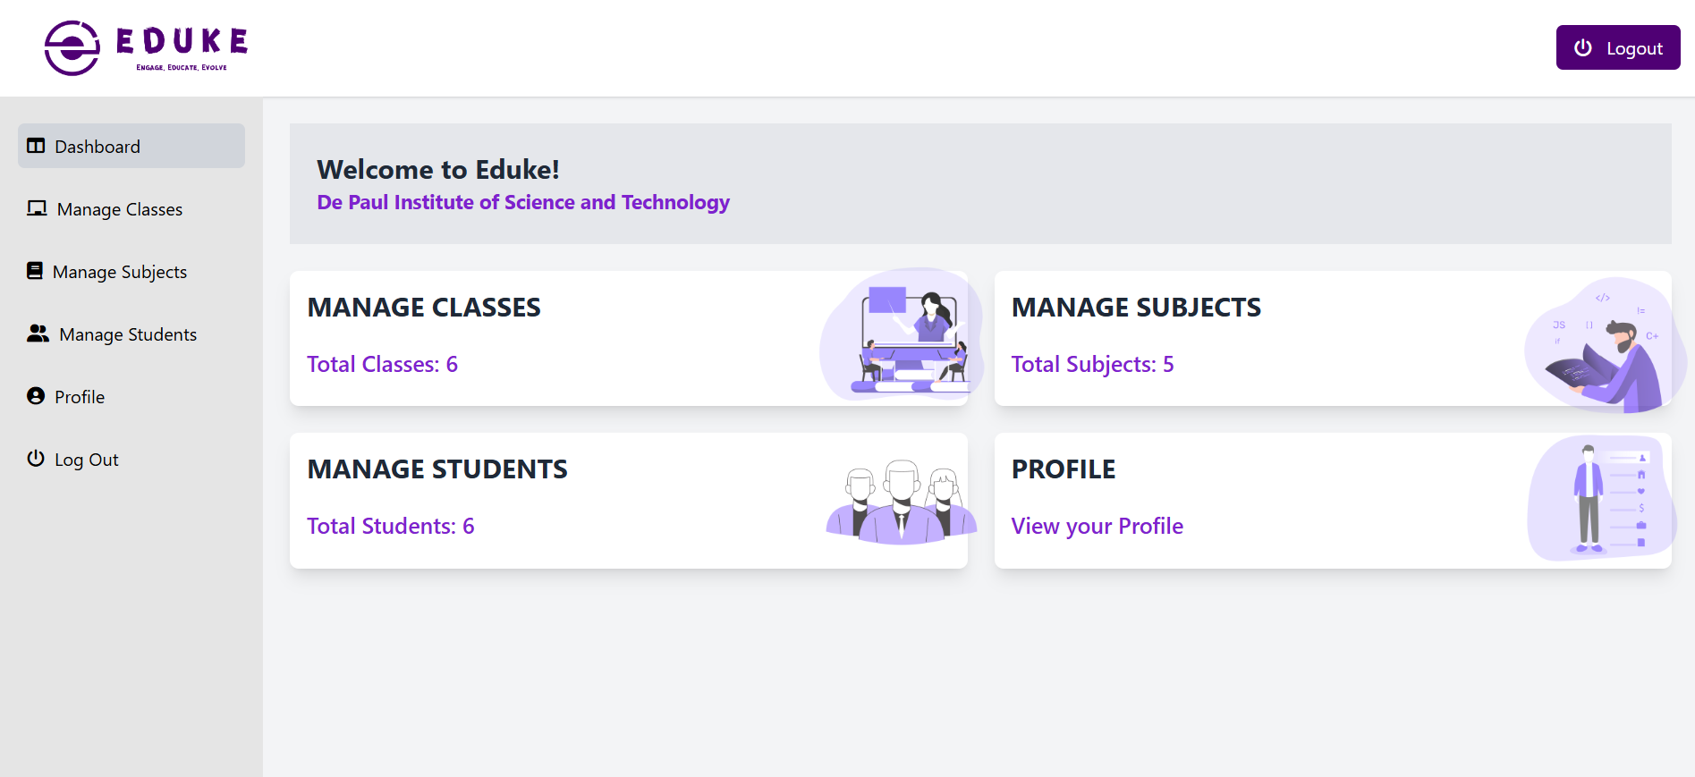
eduke
Project Screenshots

Slide 39
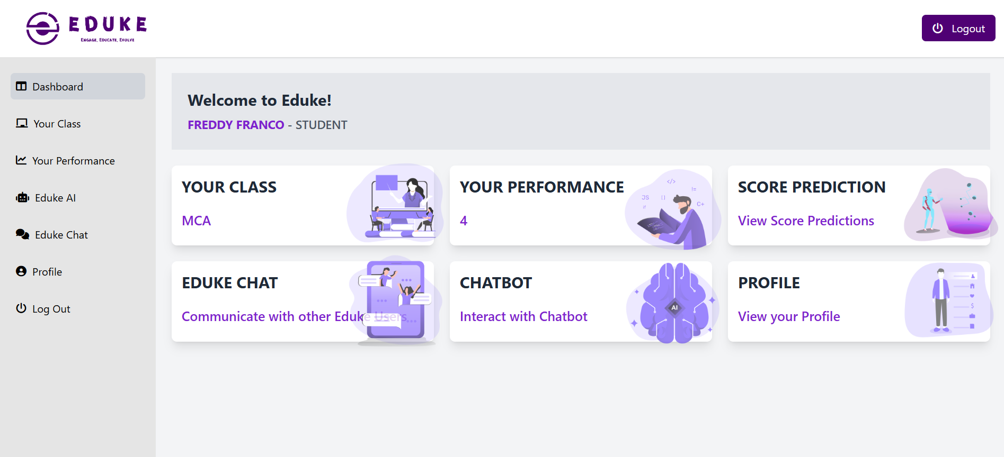
eduke
Project Screenshots

Slide 40
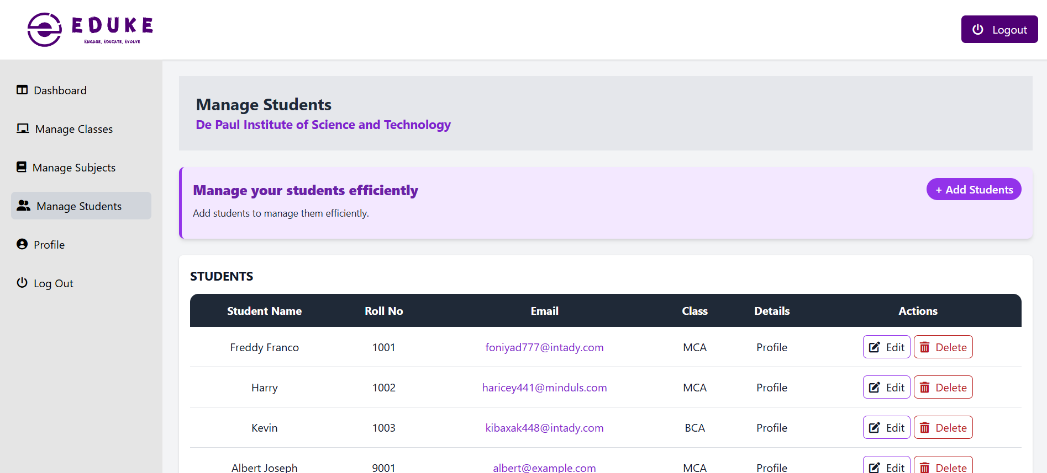
eduke
Project Screenshots

Slide 41
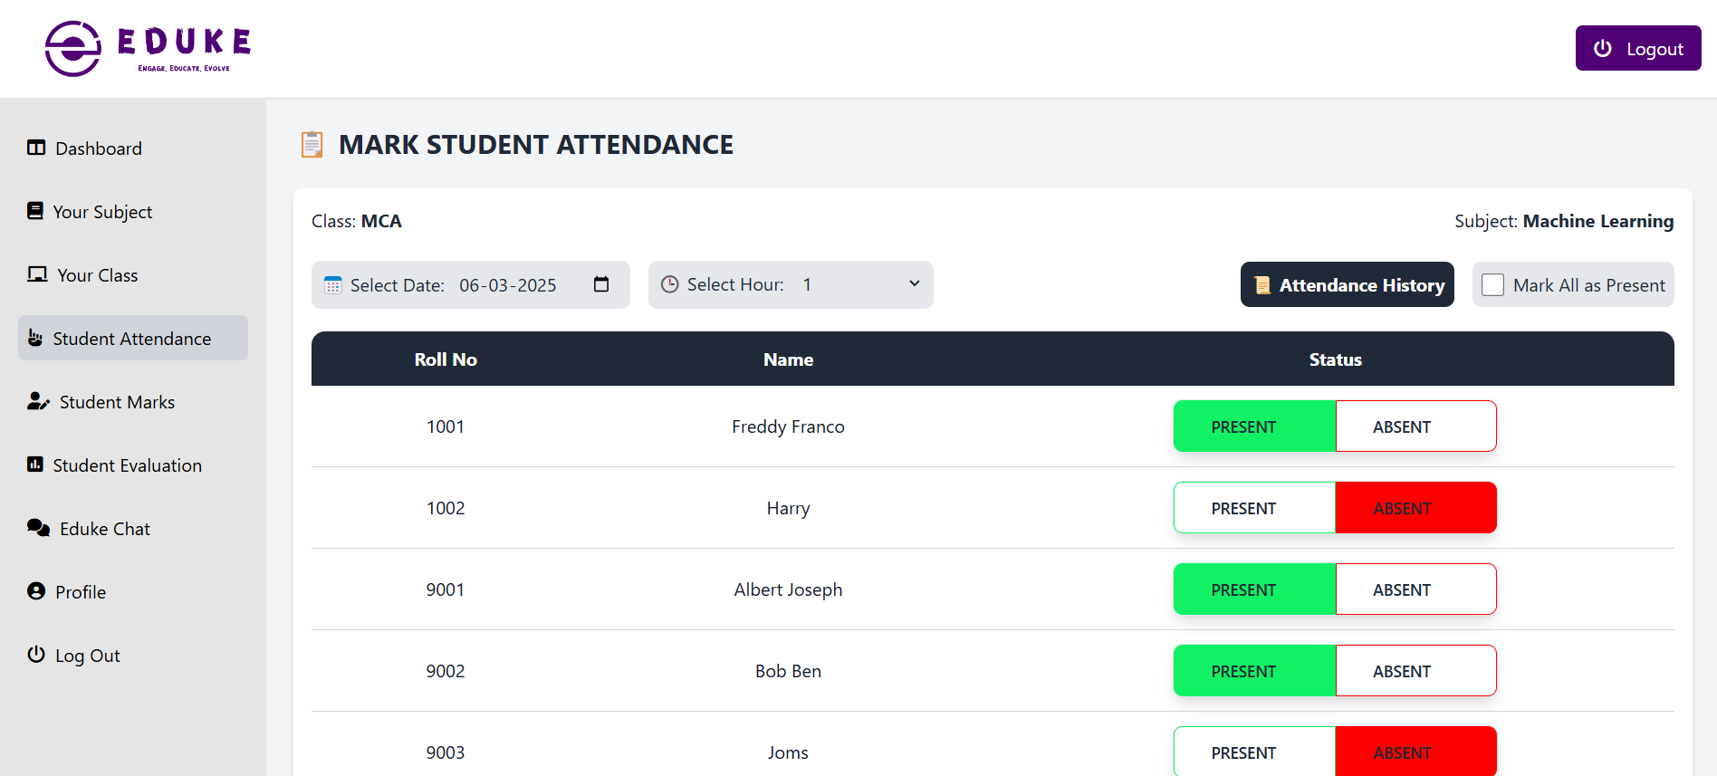
eduke
Project Screenshots

Slide 42
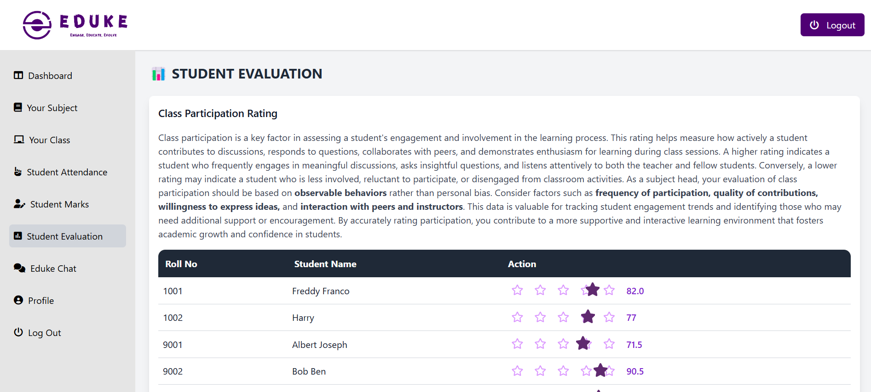
eduke
Project Screenshots

Slide 43
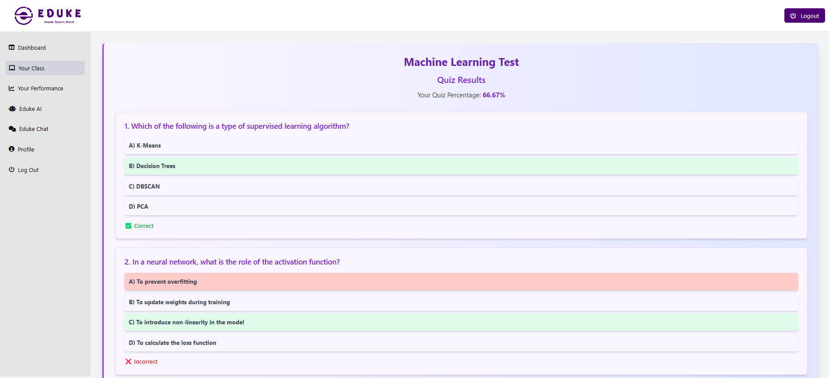
eduke
Project Screenshots

Slide 44
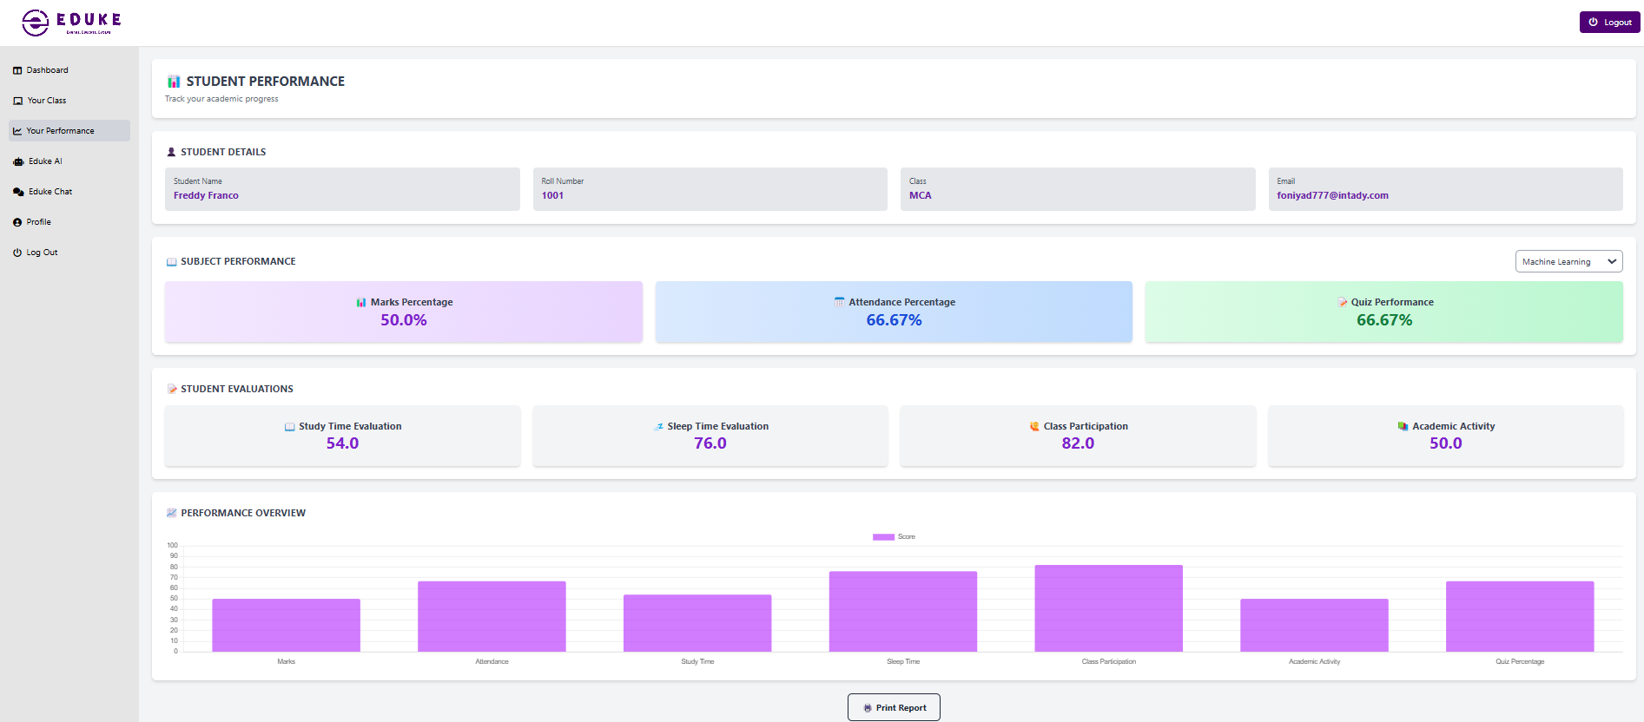
eduke
Project Screenshots

Slide 45
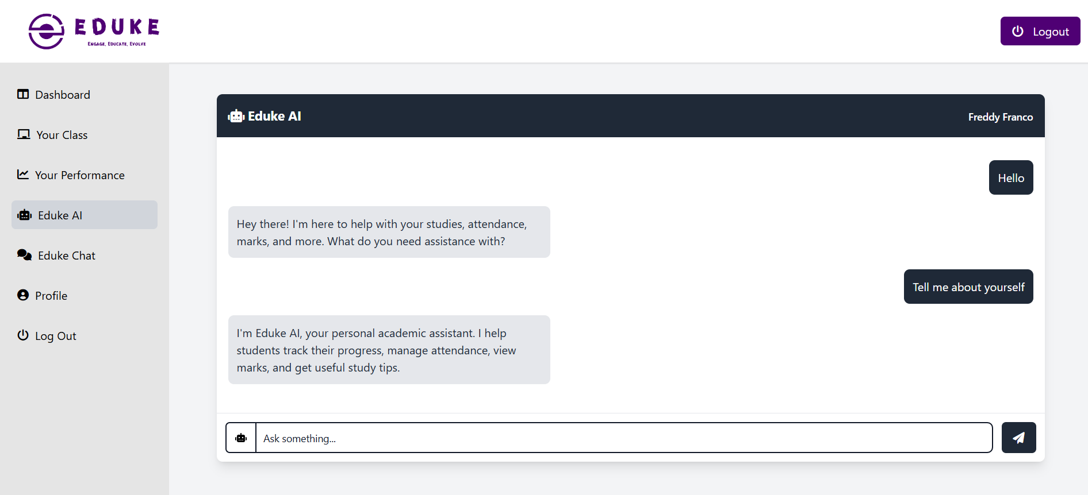
eduke
Project Screenshots

Slide 46
eduke
EDUKE Future Enhancements
Enhanced Security & Role-Based Access: Strengthening security measures with two-factor authentication and better role-based access controls.
Parent-Teacher Meeting Scheduler: Allowing parents and teachers to schedule virtual or in-person meetings through the platform for better collaboration.
Mobile App Integration: Developing a mobile application to provide seamless access to Eduke’s features on smartphones and tablets.
Multi-Language Support: Expanding the platform to support multiple languages, making it accessible to a diverse range of users.
Handwritten Notes Recognition: Integrating AI-based recognition to convert handwritten notes into digital format for easy access and sharing.
AI-Powered Study Planner: Providing personalized study plans based on students’ performance, deadlines, and time availability.
Gamified Learning: Introducing interactive and gamified learning modules to keep students engaged while improving their academic performance.

Slide 47
eduke
Conclusion
Eduke is an innovative AI-powered platform designed to enhance academic performance tracking and management. By integrating predictive analytics, real-time communication, and structured data management, it bridges the gap between students, teachers, and parents. With its user-friendly interface and intelligent features, Eduke empowers educational institutions to make data-driven decisions, ensuring better learning outcomes and academic success.
Eduke transforms education through data-driven insights, fostering a smarter and more connected learning environment.

Slide 48



eduke
THANK YOU
We appreciate your time and interest in
EDUKE
An Academic Performance Prediction and
Management System.
For GitHub Repository
www.github.com/theRealSain/eduke
Contact
sainsaburaj@depaul.edu.in

